Slide 1

Car Rental
Cartko

Slide 2
Contents of This Template
Introduction
Business Description
Snapshots
ER & UML Diagram
Best Sellers
Our Network
Our Philosophy
Conclusion

Slide 3
01
02
About Our Company
Our Network
03
04
Our Clients
Expected Projection
Introduction
Rent your favorite car
Our Network is applicable all over the india.
Every Middle-class Member
API is between Client &
Agency

Slide 4
Business Description
This is what we do
We had Tie-up with local travels
We also check the condition and security of the car
We verify the driving license of the customer before hand over the car.
We check the condition of the car after the every trip.

Slide 5
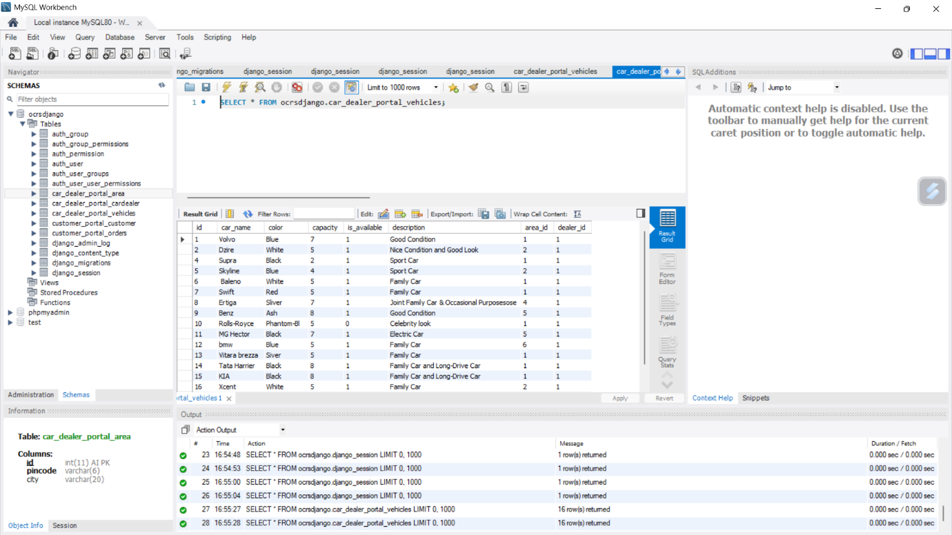
Snapshot

Slide 6
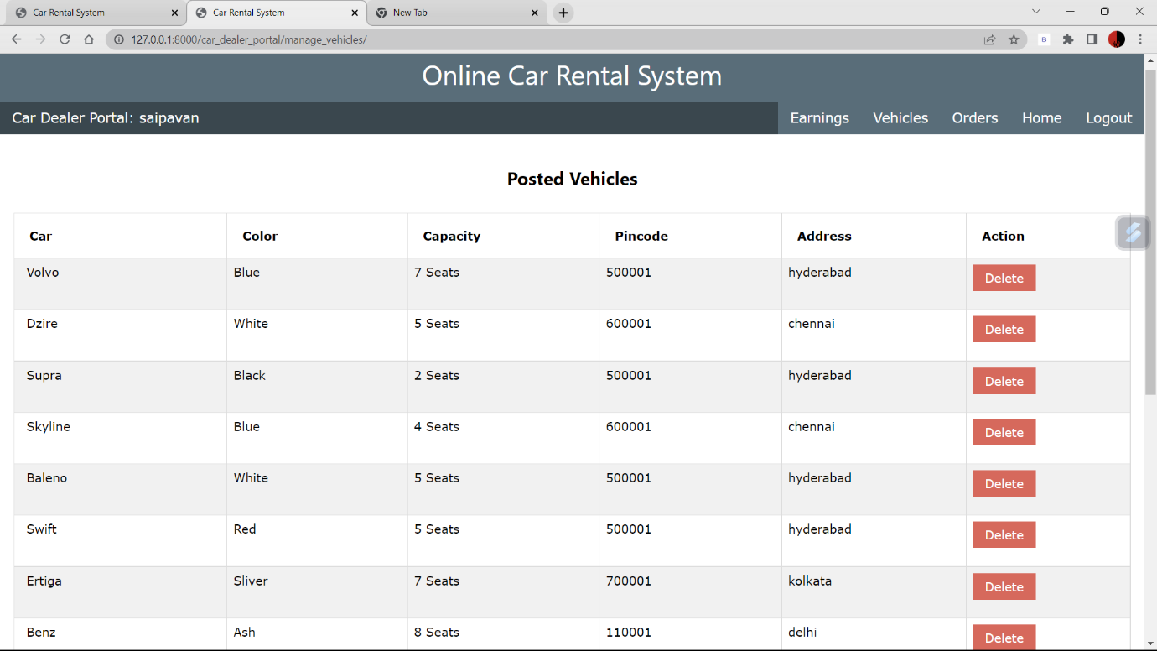
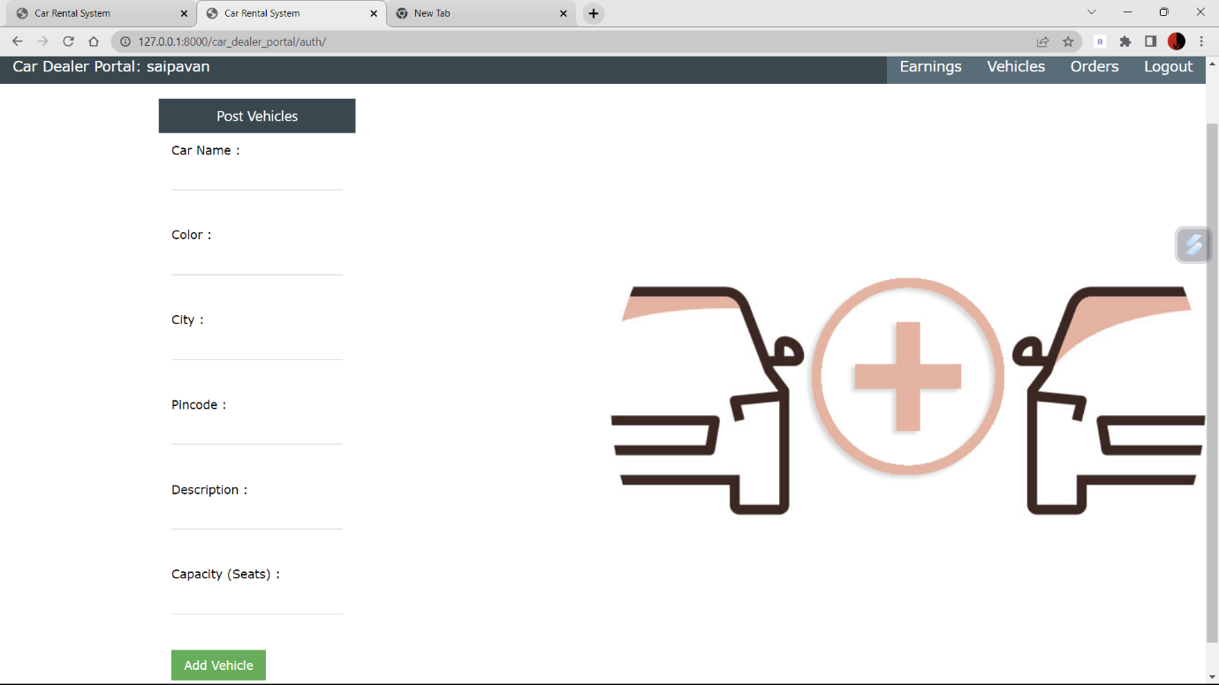
Snapshot

Slide 7
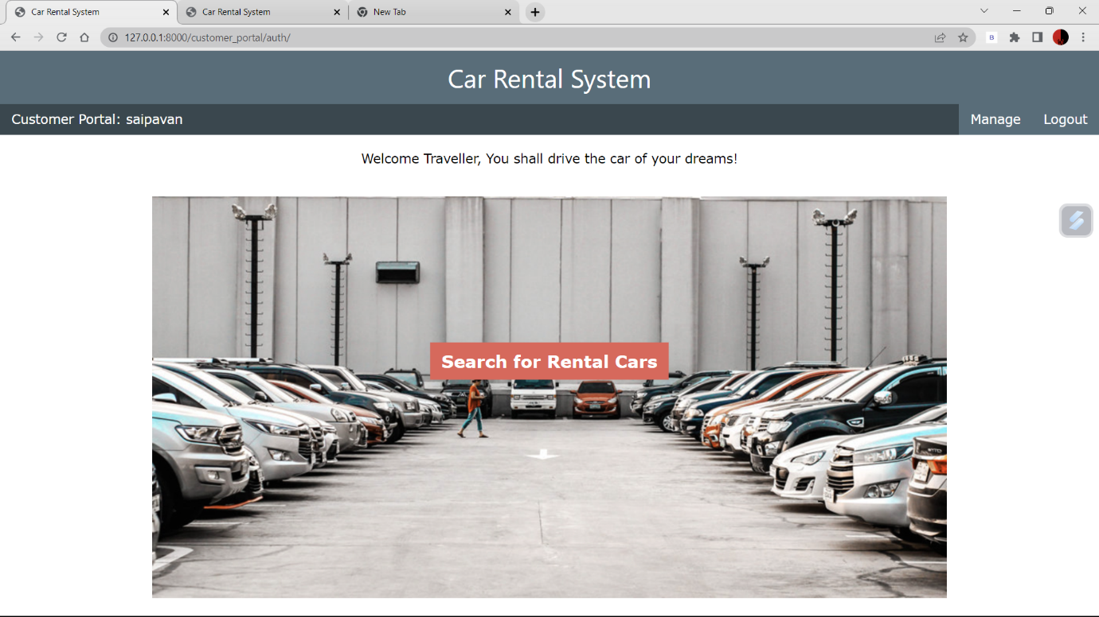
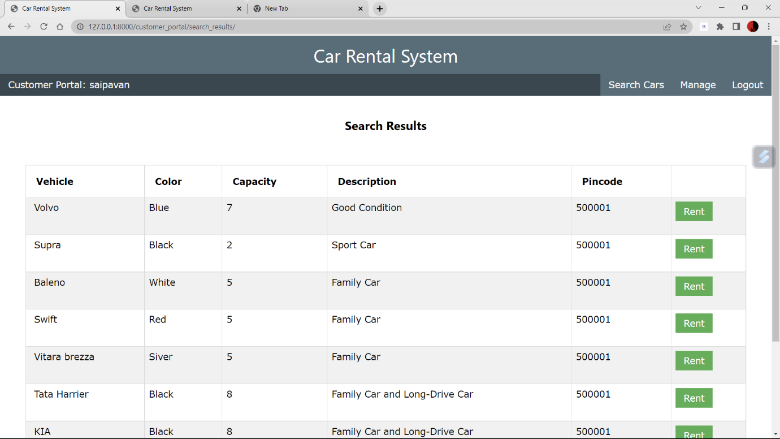
Snapshot

Slide 8
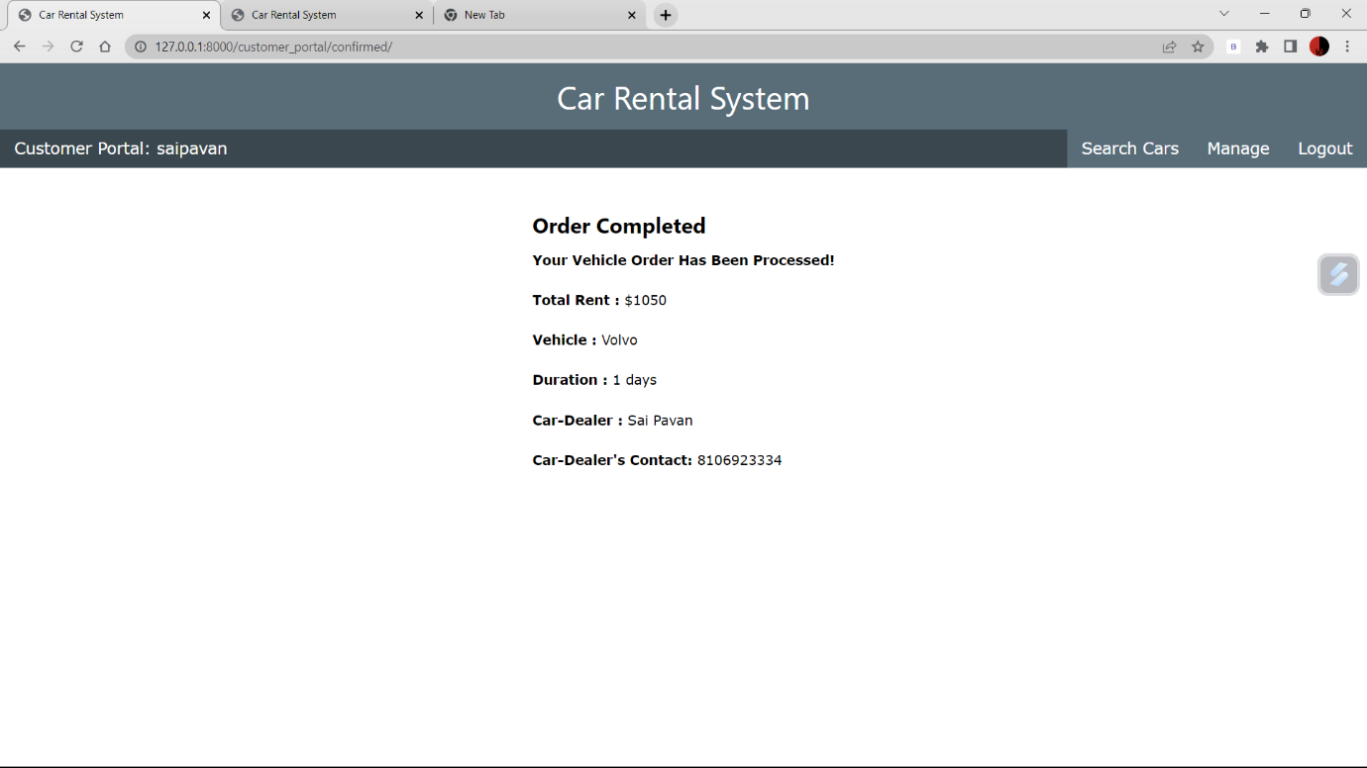
Snapshot

Slide 9
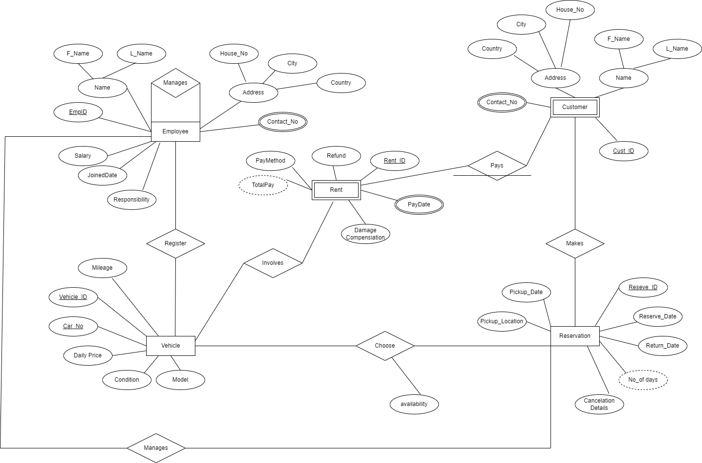
ER Diagram

Slide 10
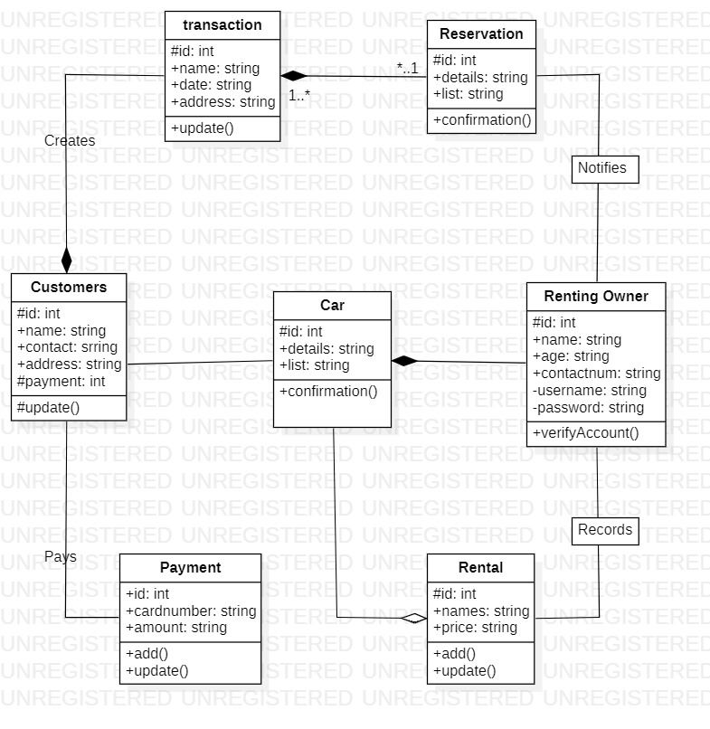
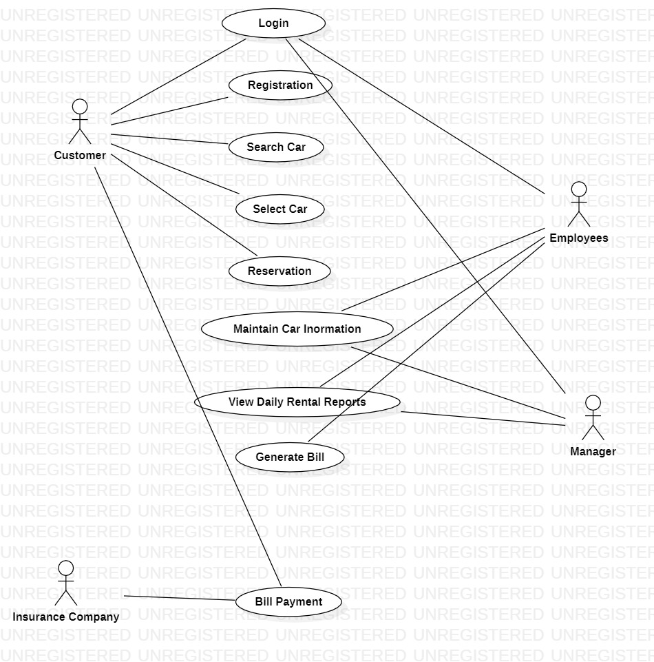
UML Diagram

Slide 11
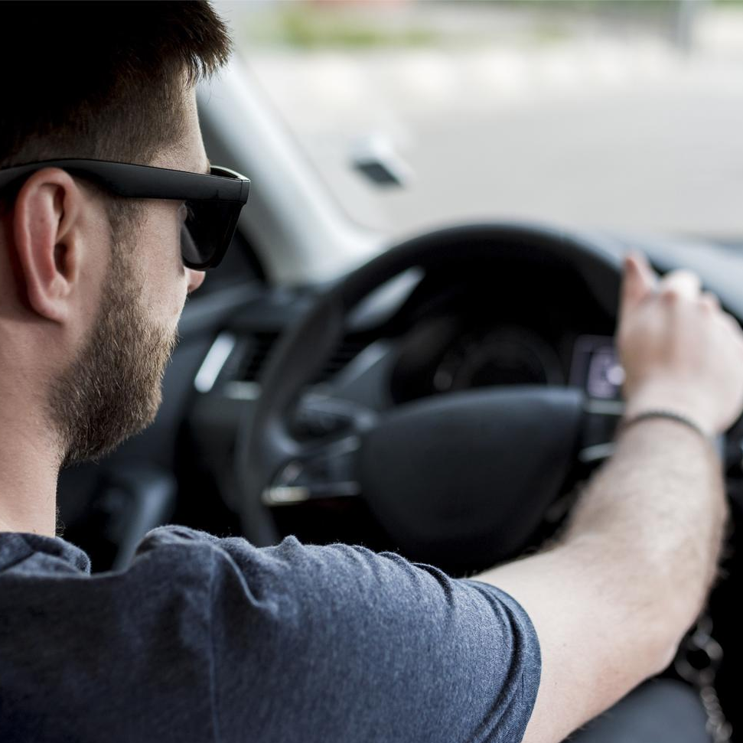
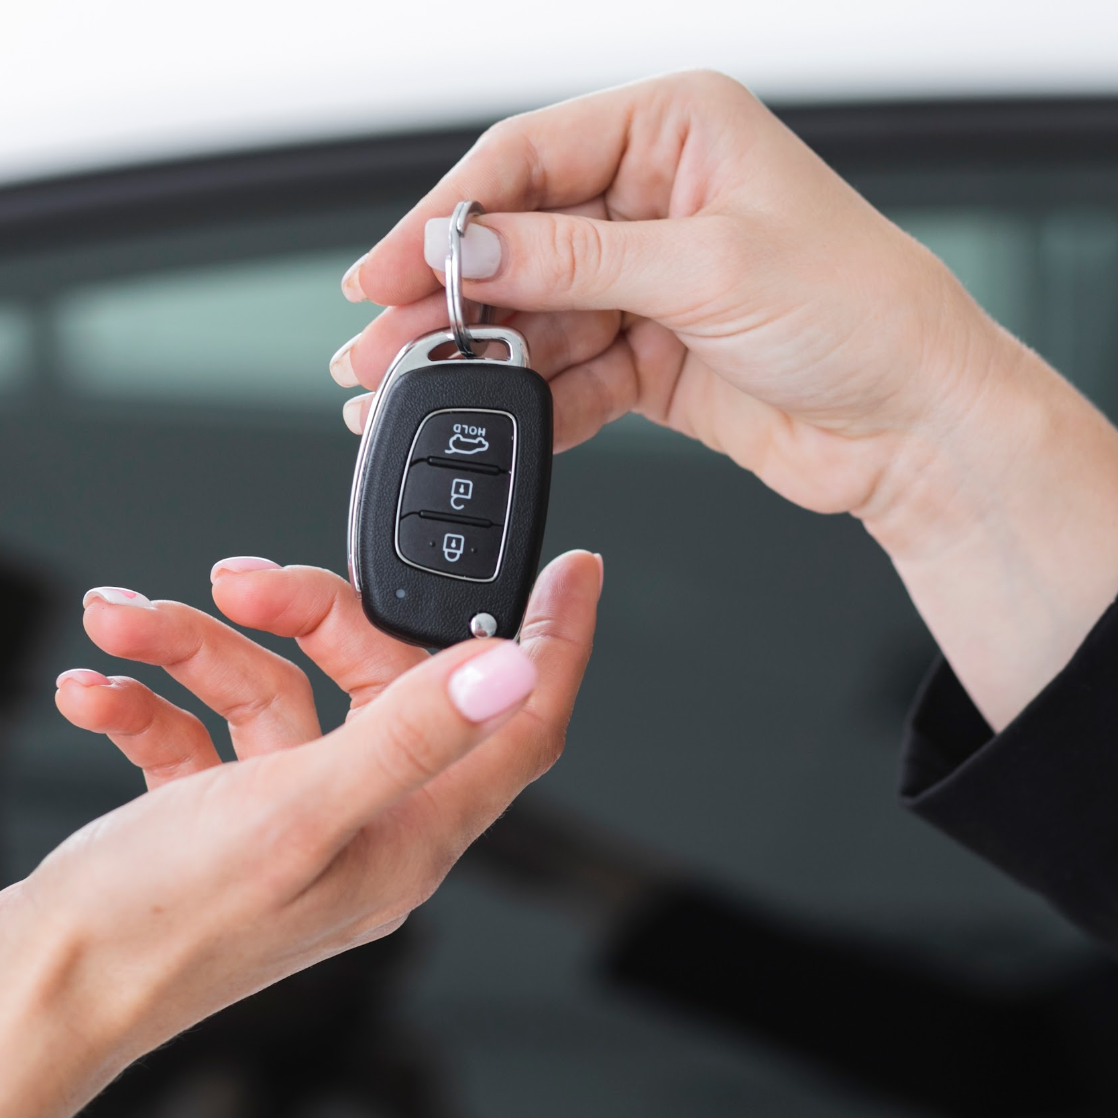
Best Sellers
Private Driver
Complete Car
We can give verified Drivers
We give the self-rental car

Slide 12
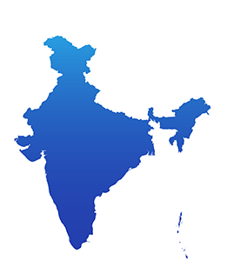
Our Network
Our Networks that are located around India .

Slide 13
Our Philosophy
Mission
Vision
Values
To Satisfy the every customer aspects .
Budget-Friendly cars to every-one.
Our Priority is customer safety.

Slide 14
Conclusion
When every activity related to the vehicle rental business was restricted to a physical place alone.
It is a web-application and open for all .
We maintain confidentiality of data of the all users and employees.

Slide 15
Thank You
Our Team Members
Sai Pavan R
Sai Vamsi T
Abhiram Patel U
Gowtham Reddy S

